Slide 1

HOSPITAL MANAGEMENT System
Under Guidance of:
Mr. NARENDRA
Assistant Professor
Dept Of Cse
Mr. VEERABRAHMAM
Assistant Professor
Dept Of Cse
Presented By:
Y. Pavan kumar(191FA04057)
G.Jayanth (191FA04380)
m. Saathwik(191FA04042)
v. Avinash(191FA04053)
Department of Computer Science and Engineering
VFSTR Deemed to Be University

Slide 2
INDEX
Introduction
Problem Statement
Software Requirements
Hardware Requirements
Function Requirements
Screenshots
Conclusion
DEPARTMENT OF COMPUTER SCIENCE AND ENGINEERING
01/04/2022
2

Slide 3
INTRODUCTION
Now a days many people are going to hospital due to health issues.
Many of the hospital use paper based document’s to store regard of the particular patient.
The work become quite difficult like if we want to know the no of people having appointment today or tomorrow we need to search 4 or 5 pages in the register.
Which wastes time.
In order to avoid wasting of time we developed a basic java database application
Which is used to store and display many of the tasks done in hospital. that saves time
DEPARTMENT OF COMPUTER SCIENCE AND ENGINEERING
01/04/2022
2

Slide 4
PROBLEM STATEMENT
A system to manage the activities in a hospital
Patients request for appointment for any doctor. The details of the existing patients are retrieved by the system. New patients details Are updated in the system before they request for appointment with the help of receptionist. The receptionist confirms the appointment based on the availability of free slots for the respective doctors and the patient is informed. receptionist may cancel the appointment of tomorrow scheduled patient.
DEPARTMENT OF COMPUTER SCIENCE AND ENGINEERING
01/04/2022
4

Slide 5



SOFTWARE REQUIREMENTS
Application Developing : NetBeans
Data Storage : mysql
Java version: jdk 15
Application Developing : NetBeans
Data Storage : mysql
Java version: jdk 15
DEPARTMENT OF COMPUTER SCIENCE AND ENGINEERING
01/04/2022
5

Slide 6
HARDWARE REQUIREMENTS
Pc with given specifications:
Ram:8 gb
Storage:1tb hdd
Processor : i5 9th Gen
Os : Windows
DEPARTMENT OF COMPUTER SCIENCE AND ENGINEERING
01/04/2022
5

Slide 7
FUNCTION REQUIREMENTS
MODULES DESCRIPTION:
LOGIN PAGE
REGISTER PAGE
ADMIN PAGE
DOCTOR PAGE
Receptionist PAGE
FINANCE PAGE
MEDICINE PAGE
DEPARTMENT OF COMPUTER SCIENCE AND ENGINEERING
01/04/2022
5

Slide 8
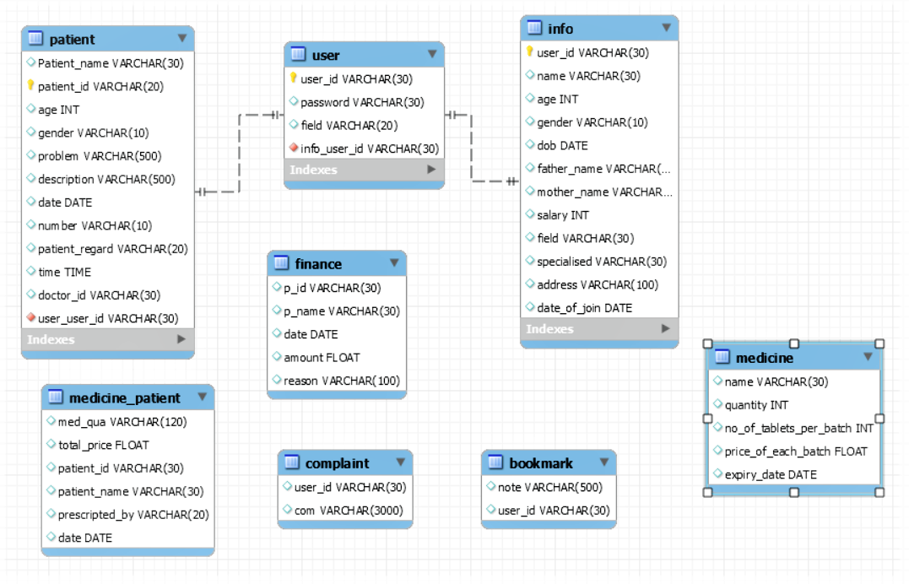
DATABASE DESIGN
DEPARTMENT OF COMPUTER SCIENCE AND ENGINEERING
01/04/2022
5

Slide 9
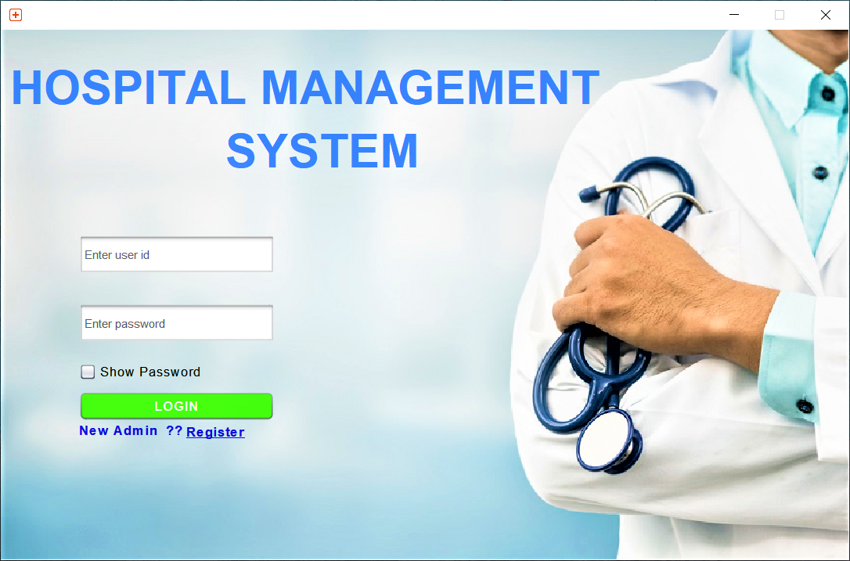
SCREEN SHOTS: LOGIN PAGE
DEPARTMENT OF COMPUTER SCIENCE AND ENGINEERING
01/04/2022
5

Slide 10
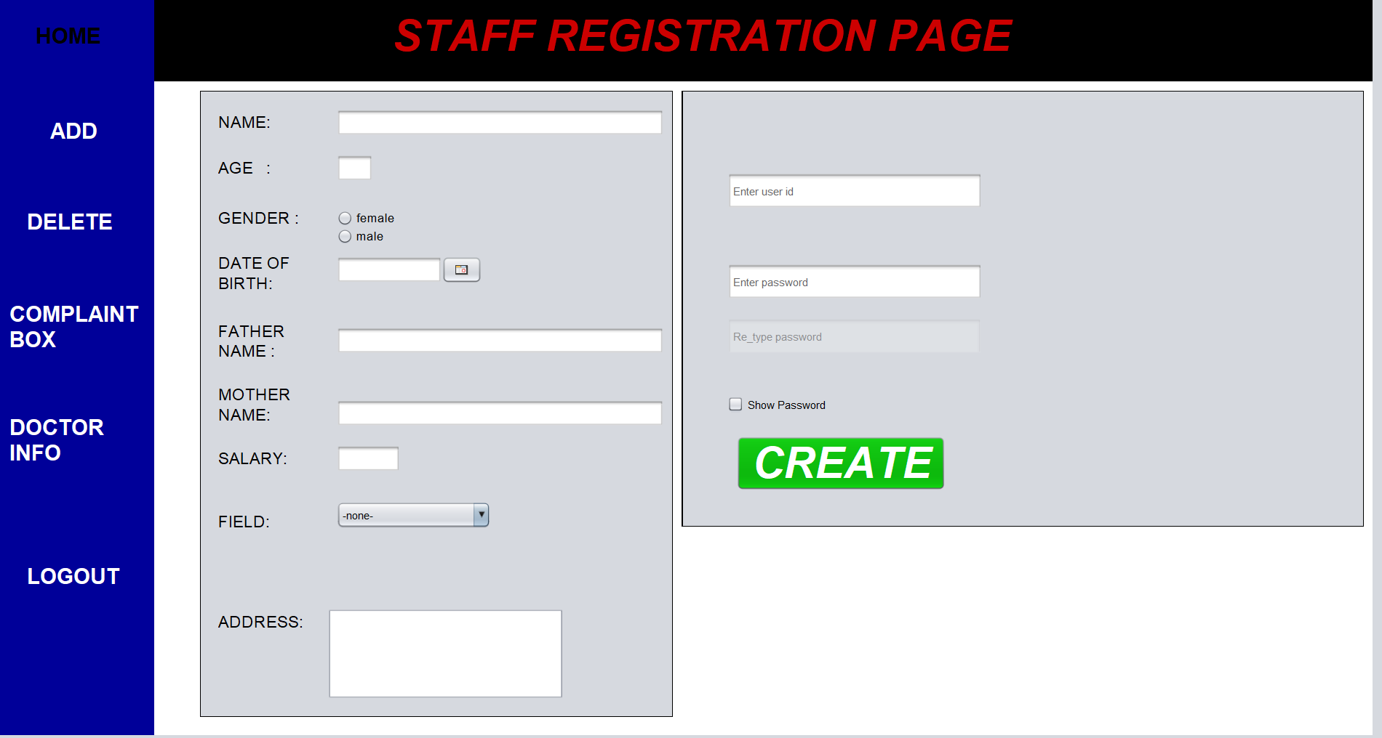
Admin
DEPARTMENT OF COMPUTER SCIENCE AND ENGINEERING
01/04/2022
5

Slide 11
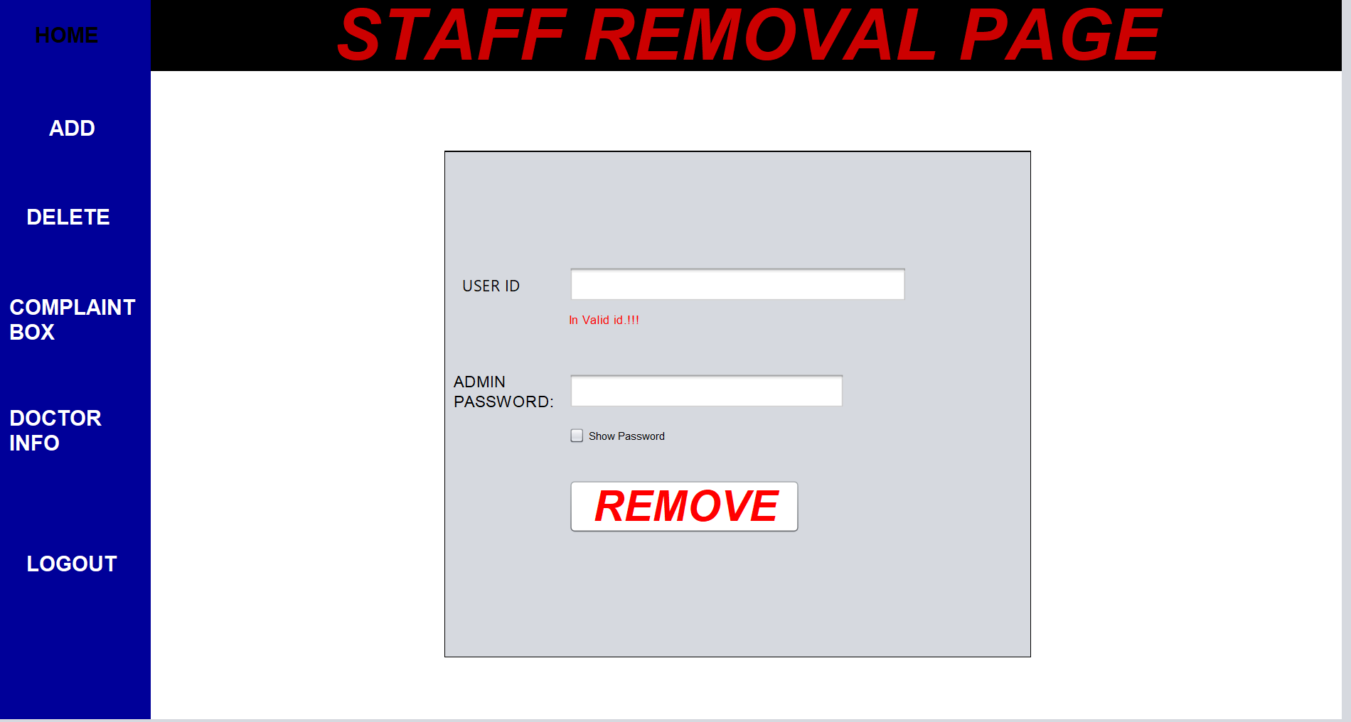
admin
DEPARTMENT OF COMPUTER SCIENCE AND ENGINEERING
01/04/2022
5

Slide 12
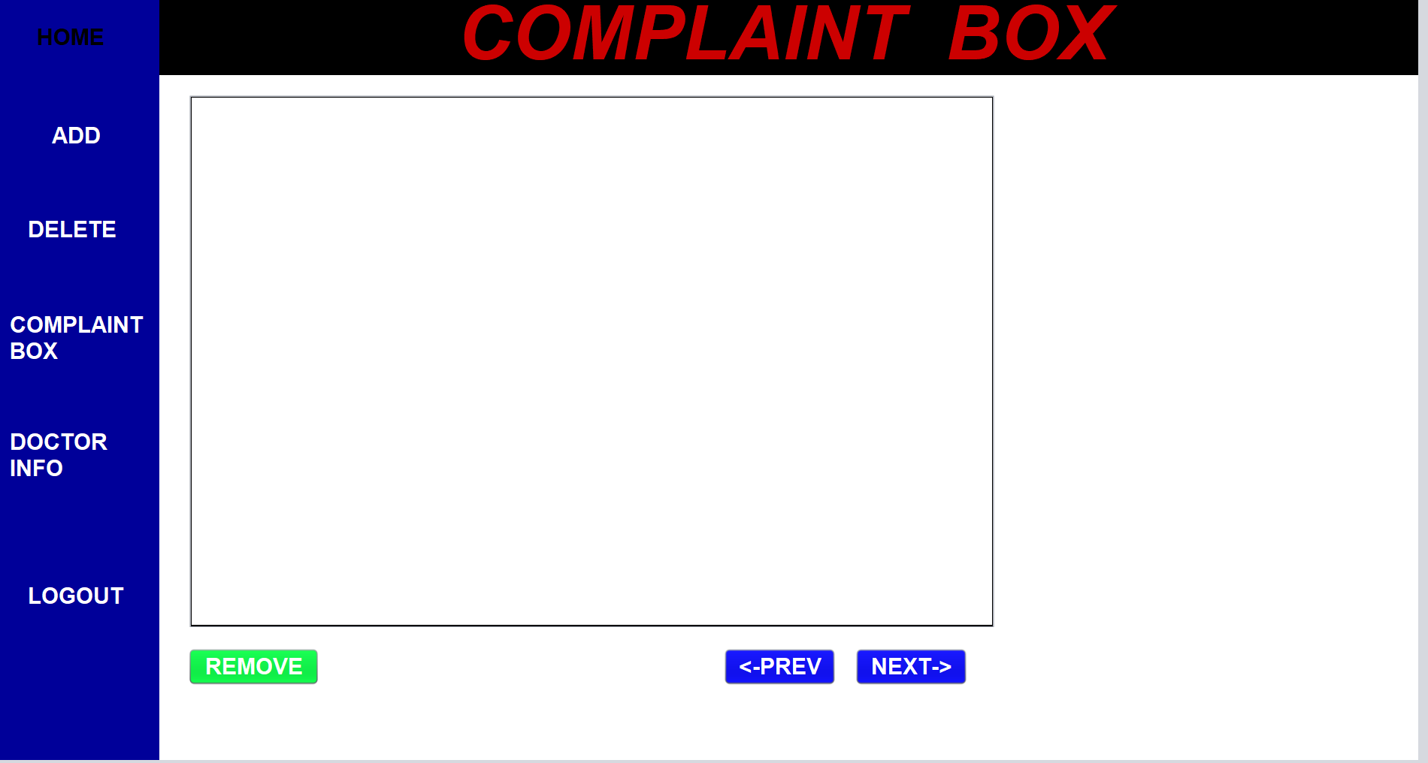
admin
DEPARTMENT OF COMPUTER SCIENCE AND ENGINEERING
01/04/2022
5

Slide 13
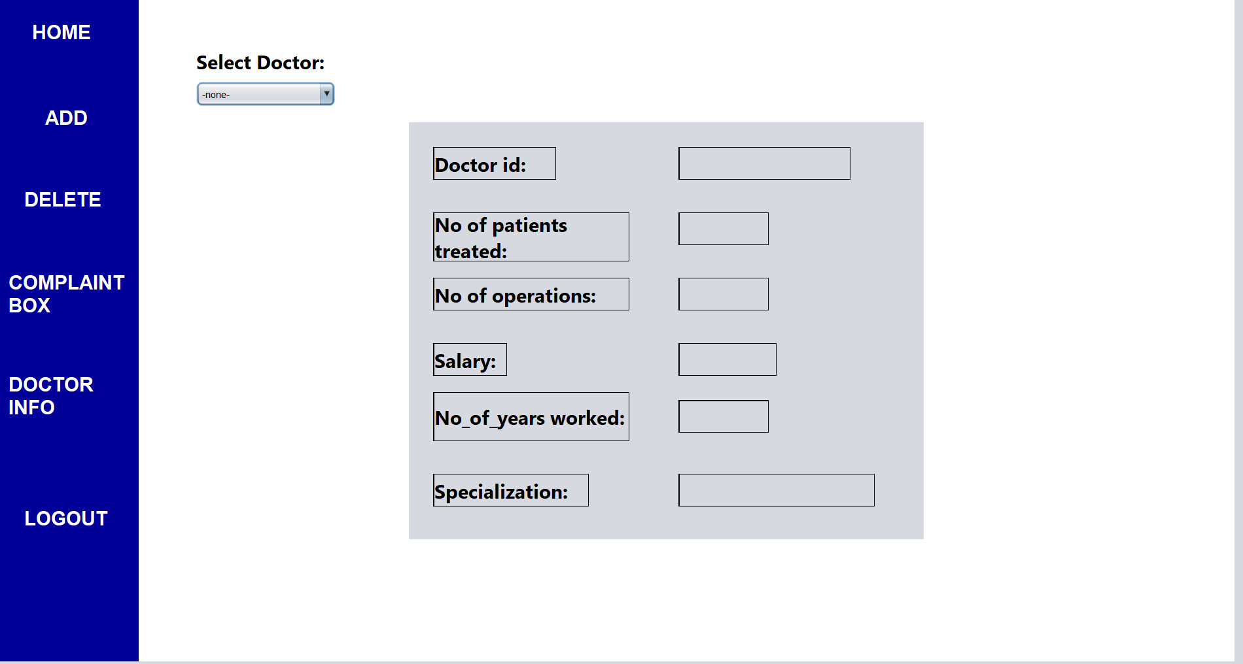
admin
DEPARTMENT OF COMPUTER SCIENCE AND ENGINEERING
01/04/2022
5

Slide 14
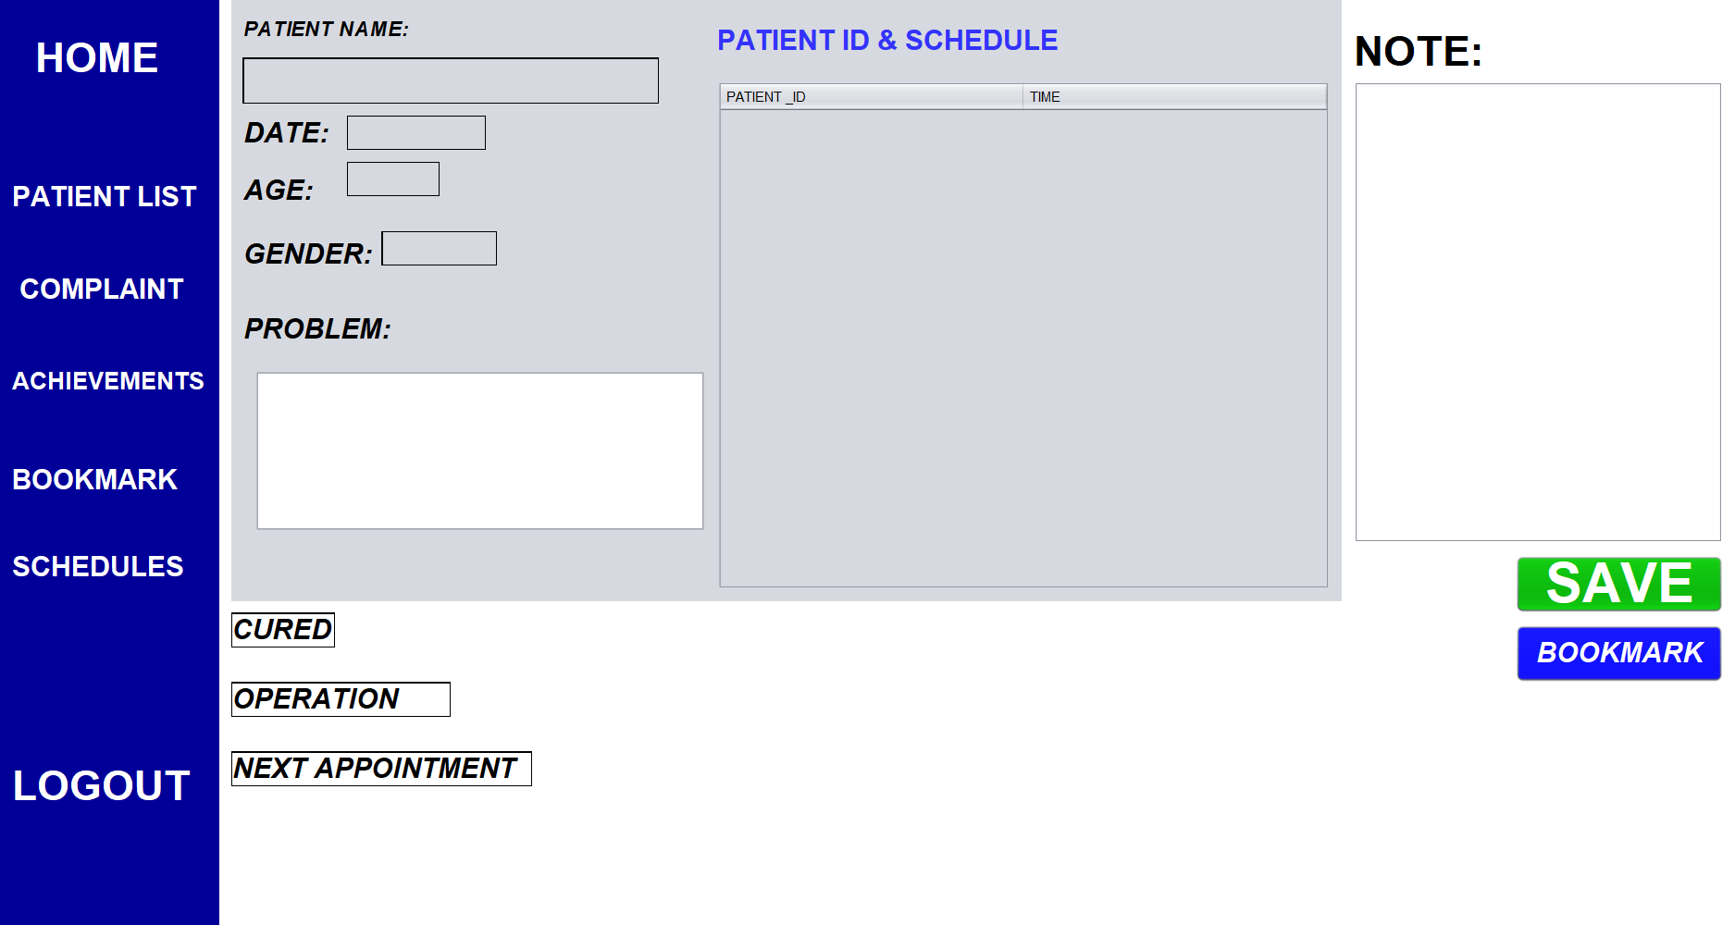
doctor
DEPARTMENT OF COMPUTER SCIENCE AND ENGINEERING
01/04/2022
14

Slide 15
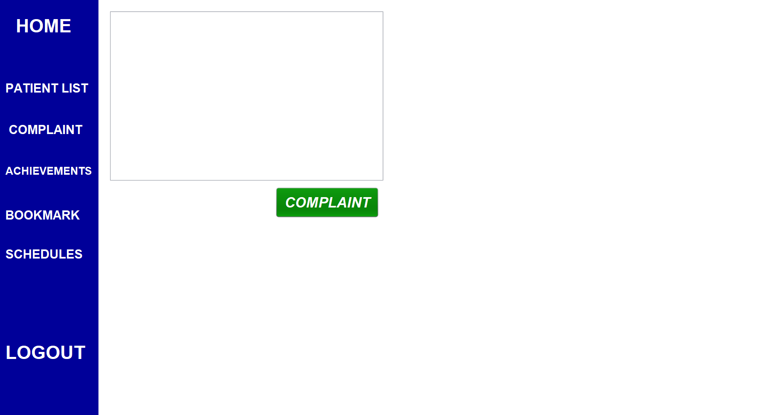
doctor
DEPARTMENT OF COMPUTER SCIENCE AND ENGINEERING
01/04/2022
14

Slide 16
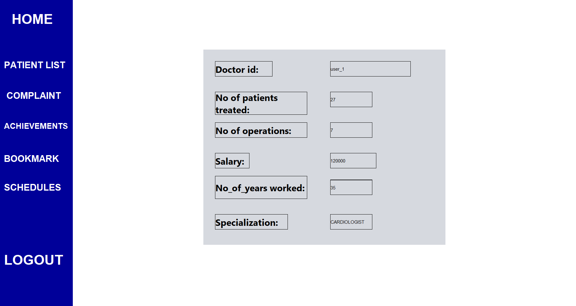
doctor
DEPARTMENT OF COMPUTER SCIENCE AND ENGINEERING
01/04/2022
16

Slide 17
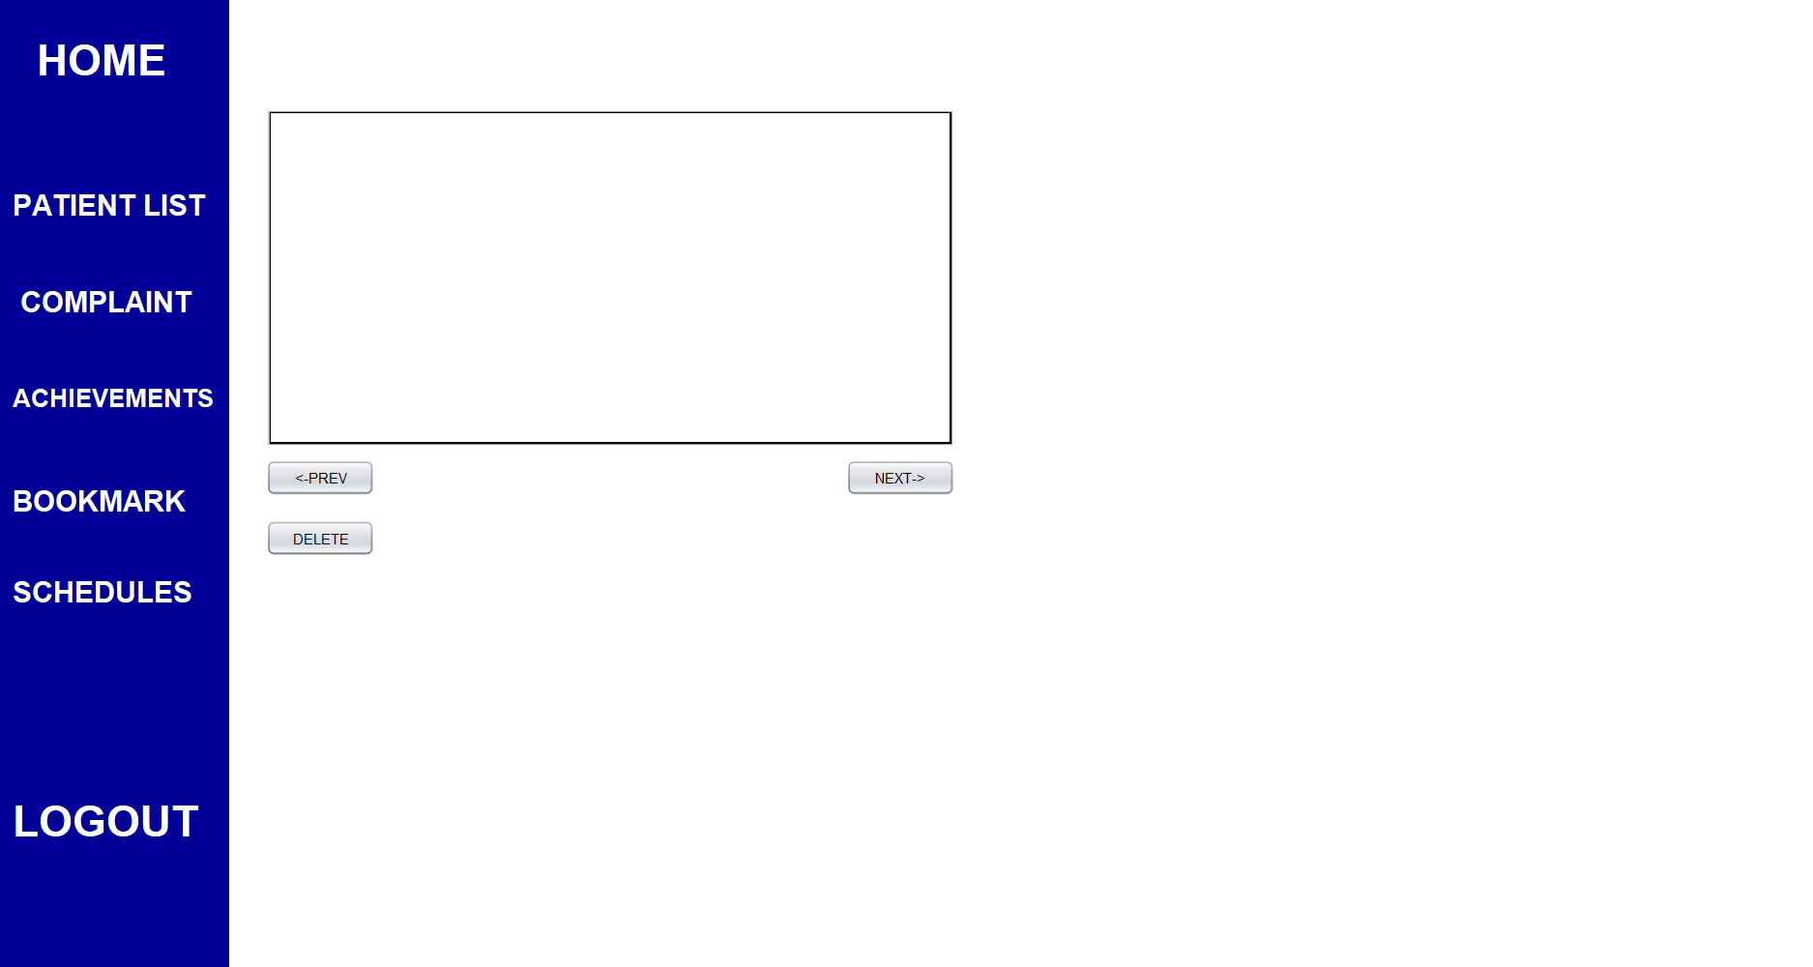
doctor
DEPARTMENT OF COMPUTER SCIENCE AND ENGINEERING
01/04/2022
16

Slide 18
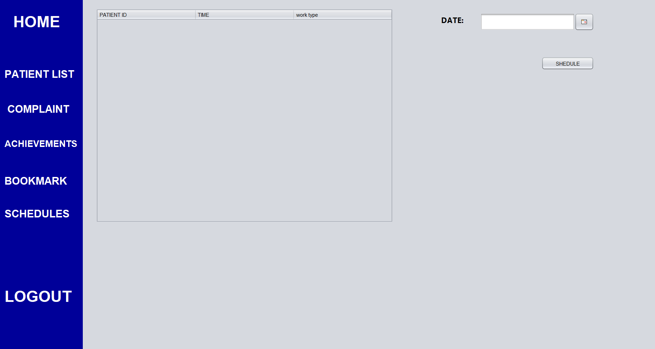
doctor
DEPARTMENT OF COMPUTER SCIENCE AND ENGINEERING
01/04/2022
16

Slide 19
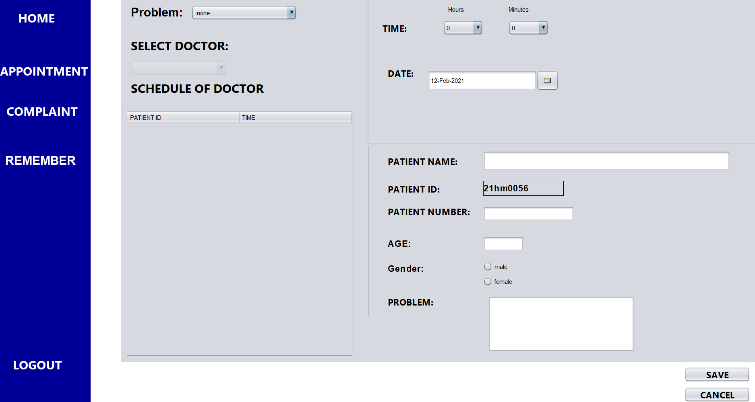
receptionist
DEPARTMENT OF COMPUTER SCIENCE AND ENGINEERING
01/04/2022
19

Slide 20
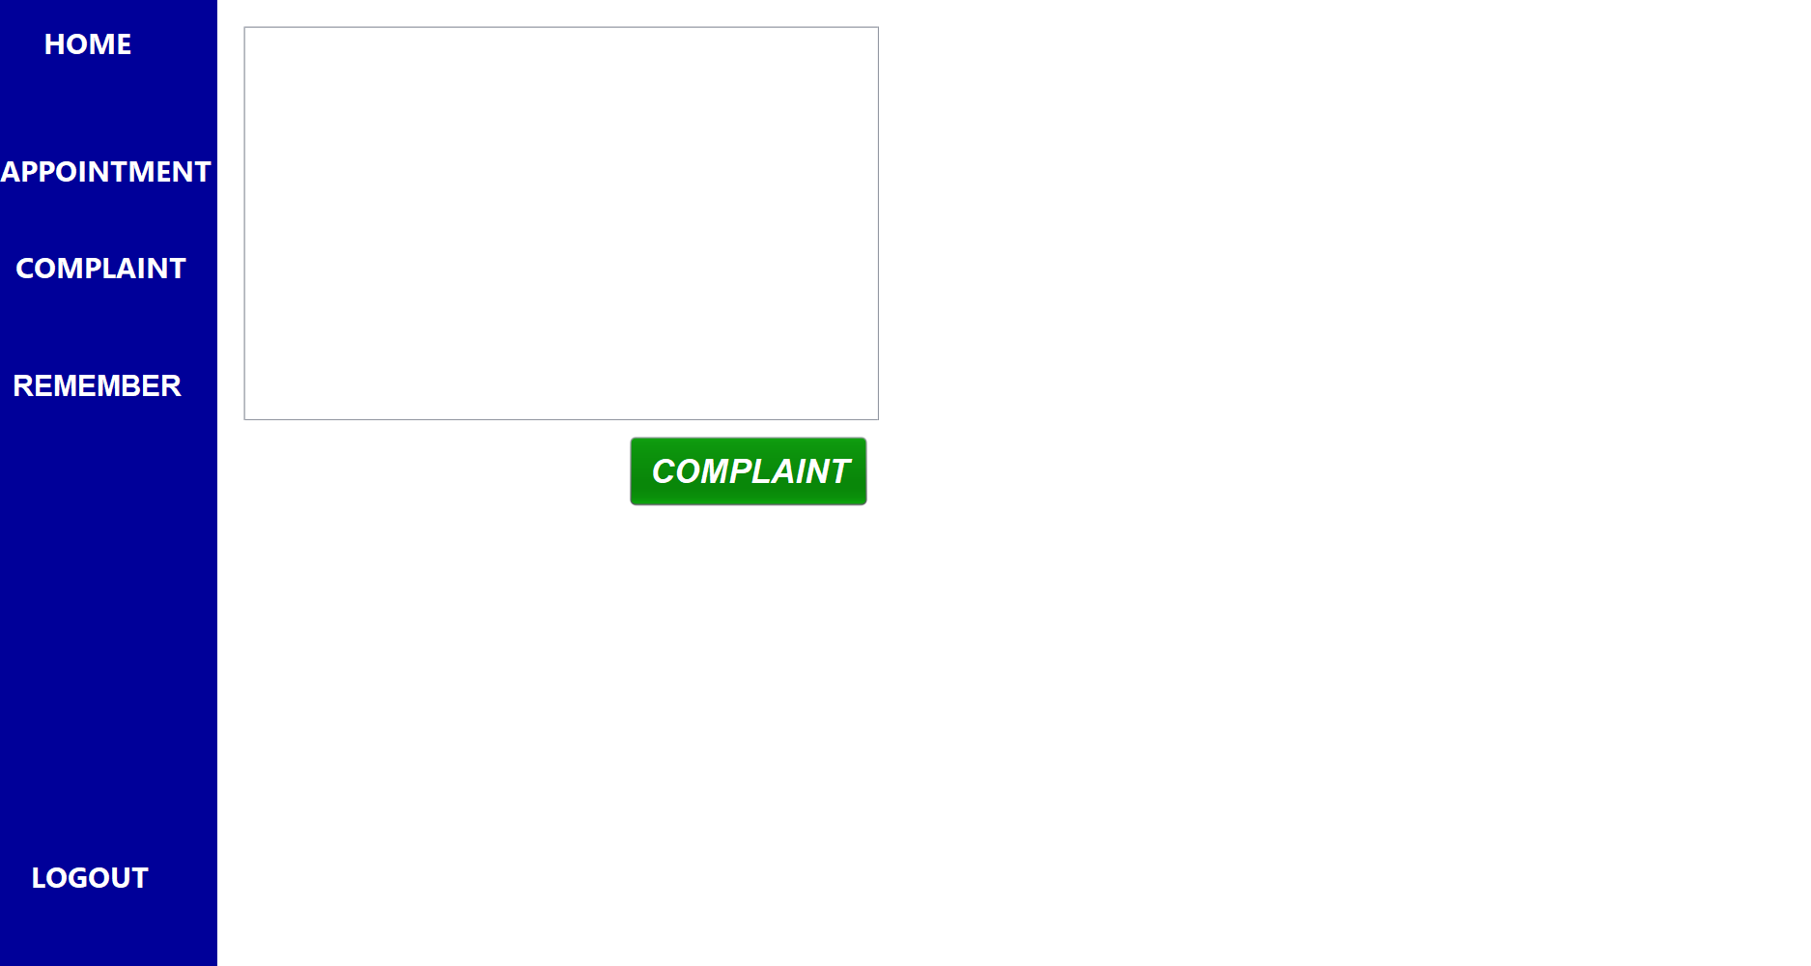
receptionist
DEPARTMENT OF COMPUTER SCIENCE AND ENGINEERING
01/04/2022
19

Slide 21
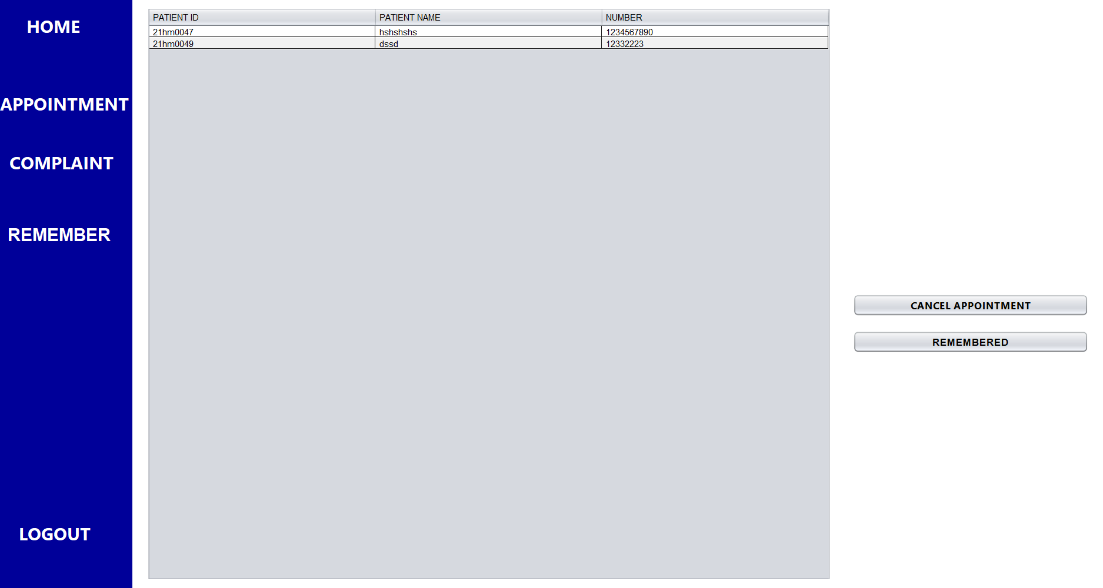
receptionist
DEPARTMENT OF COMPUTER SCIENCE AND ENGINEERING
01/04/2022
21

Slide 22
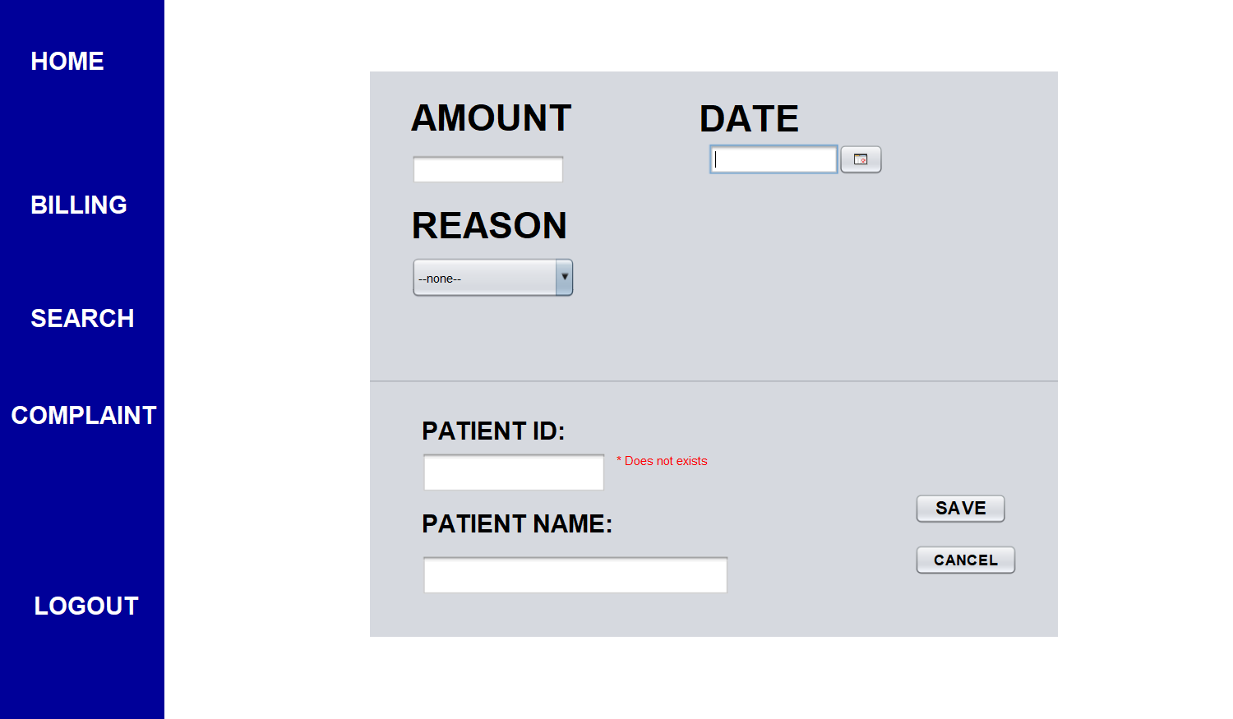
finance
DEPARTMENT OF COMPUTER SCIENCE AND ENGINEERING
01/04/2022
21

Slide 23
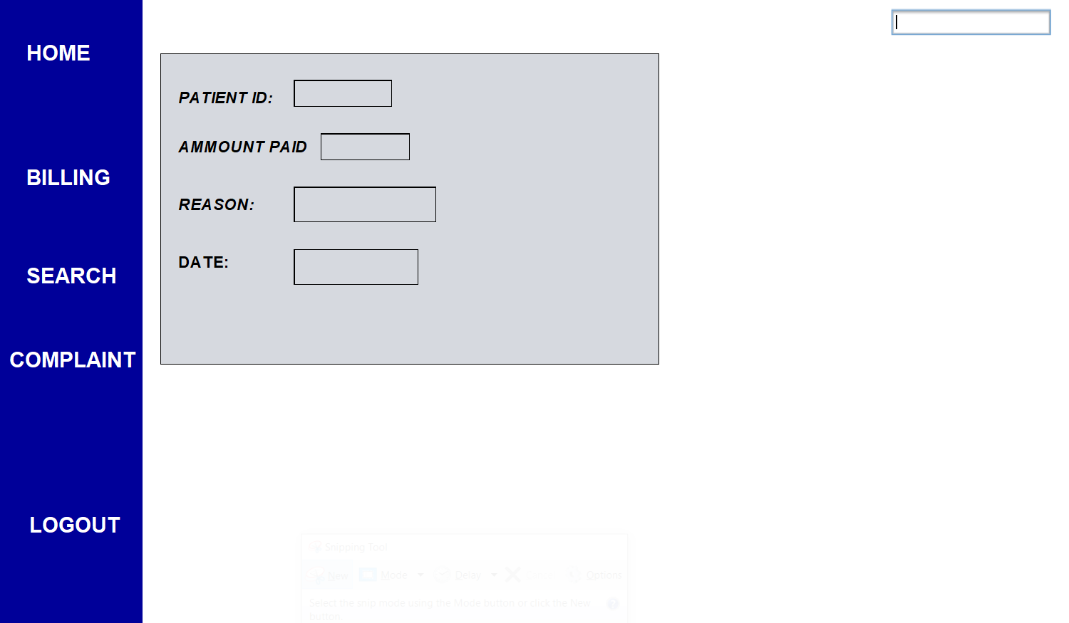
finance
DEPARTMENT OF COMPUTER SCIENCE AND ENGINEERING
01/04/2022
21

Slide 24
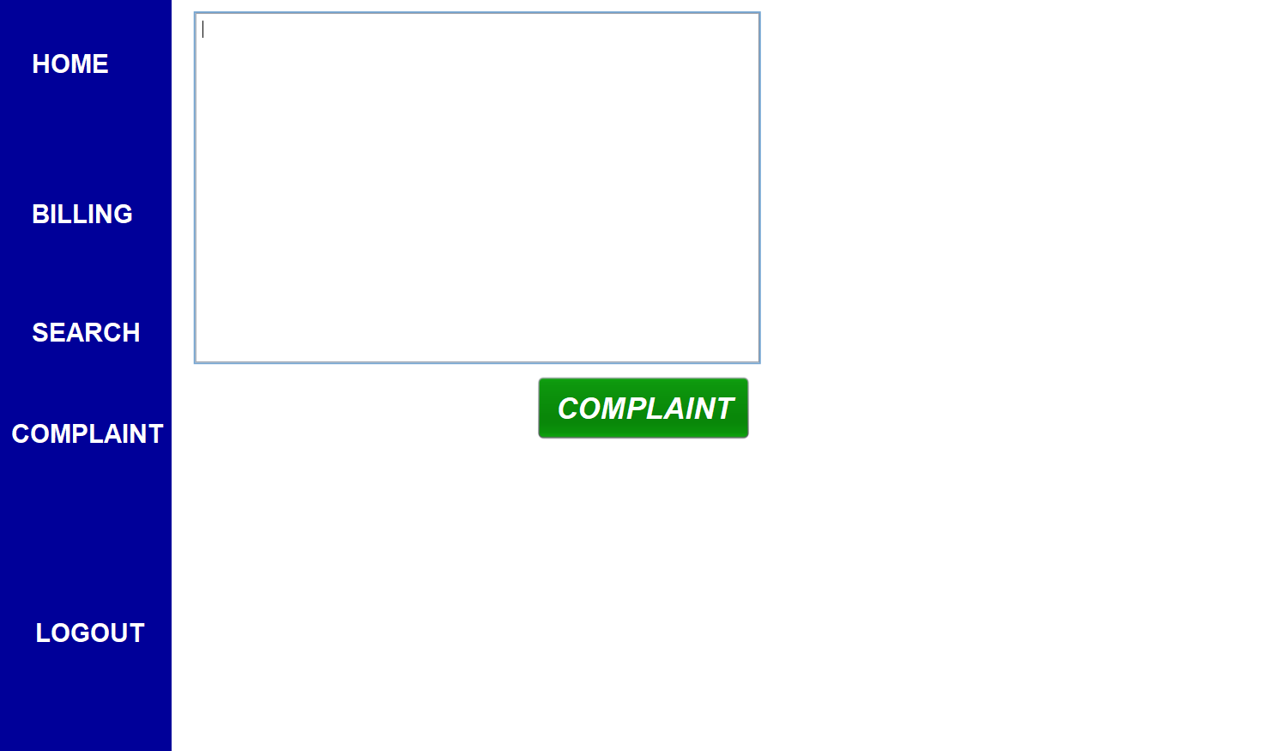
finance
DEPARTMENT OF COMPUTER SCIENCE AND ENGINEERING
01/04/2022
21

Slide 25
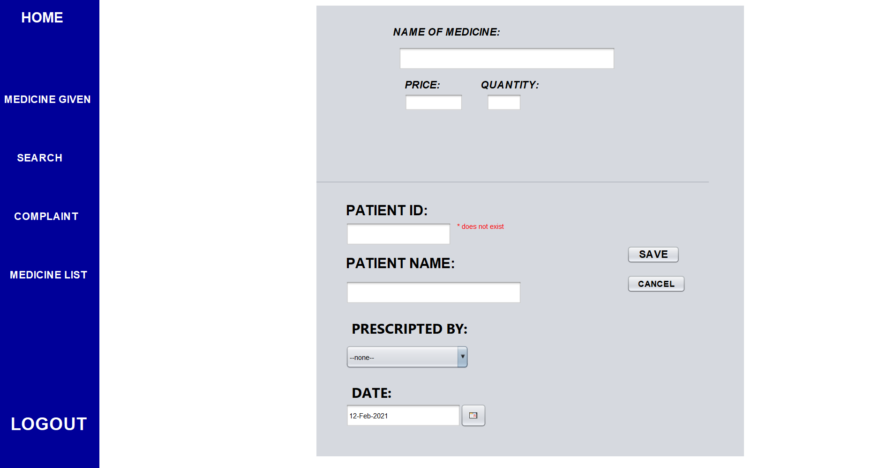
Medicine
DEPARTMENT OF COMPUTER SCIENCE AND ENGINEERING
01/04/2022
25

Slide 26
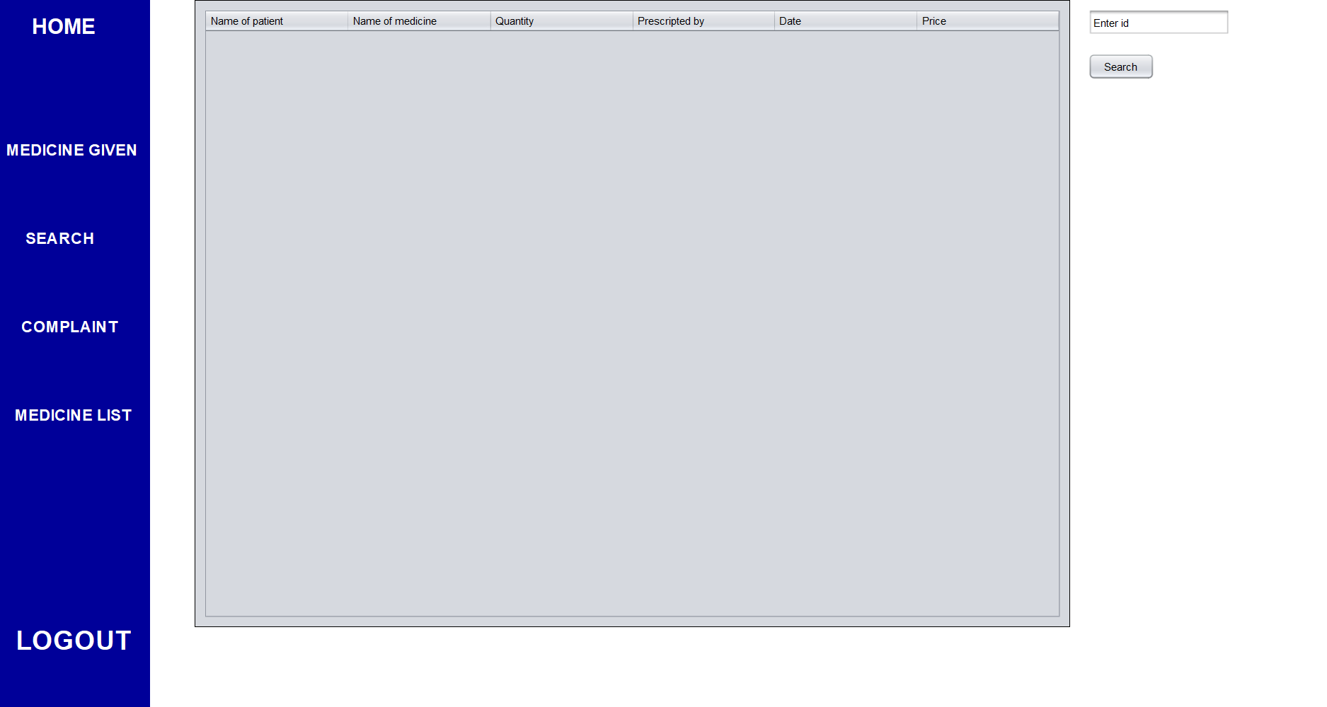
Medicine
DEPARTMENT OF COMPUTER SCIENCE AND ENGINEERING
01/04/2022
26

Slide 27
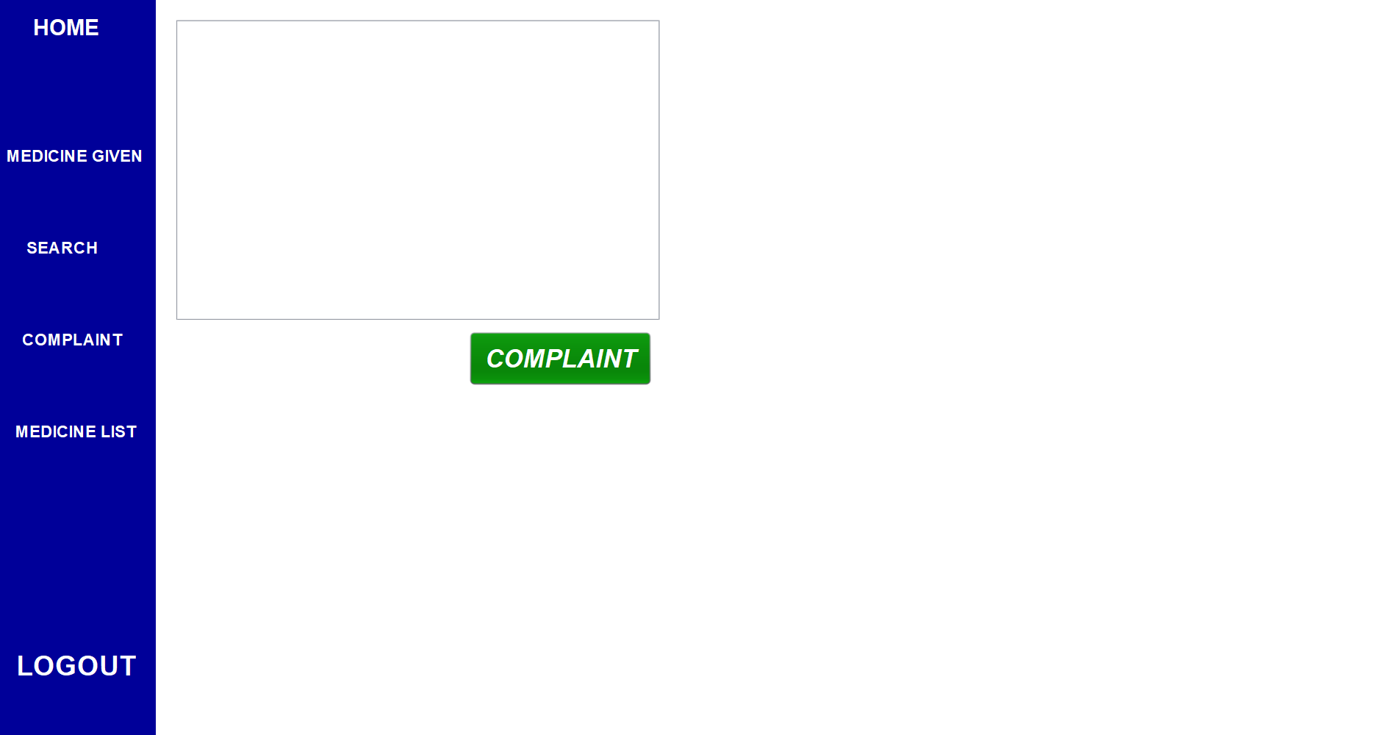
Medicine
DEPARTMENT OF COMPUTER SCIENCE AND ENGINEERING
01/04/2022
27

Slide 28
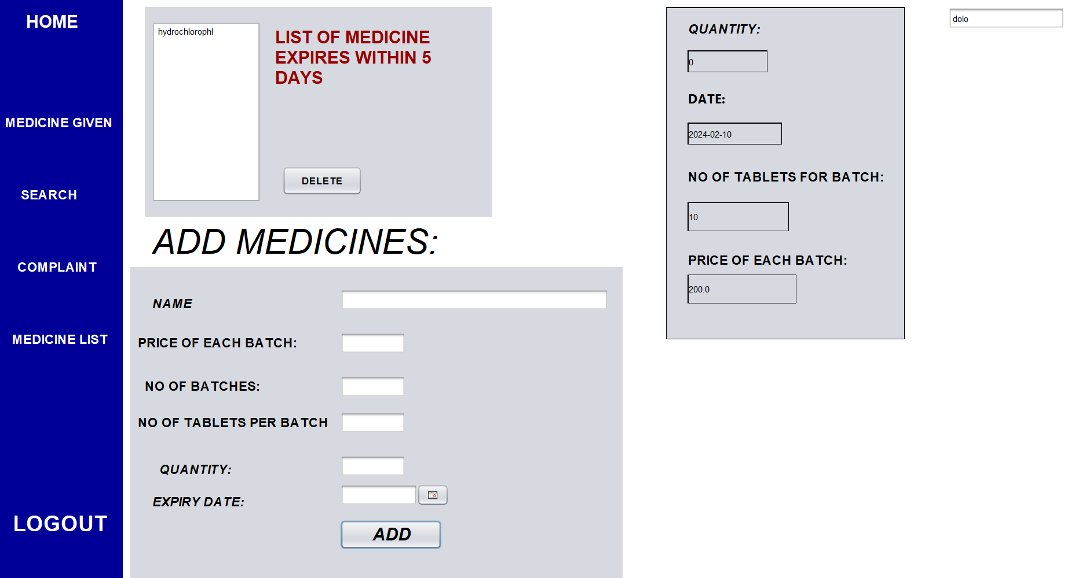
Medicine
DEPARTMENT OF COMPUTER SCIENCE AND ENGINEERING
01/04/2022
28

Slide 29
Store patient tests reports
Add payment methods
Message the patients who have appointment tomorrow
Make application very familiar to real world
Future scope:
DEPARTMENT OF COMPUTER SCIENCE AND ENGINEERING
01/04/2022
29

Slide 30
CONCLUSION
Hospital management system is all about the modernizing a hospital through use of technology. Computers helps in it and take over the manual system for quick and easy functioning. This hospital management system is a quite the reliable and is proven on many stages. All the basic requirements of the hospital are provided in the hospital in order to manage it perfectly and large amount of data can also be stored . It gives many facilities like searching for the detail of patient , billing facilities as well as the creation of test reports. So it is a important system for modern days.
DEPARTMENT OF COMPUTER SCIENCE AND ENGINEERING
01/04/2022
30

Slide 31
THANK YOU
DEPARTMENT OF COMPUTER SCIENCE AND ENGINEERING
01/04/2022
<number>

